Slide 1
Training and Evaluating a GoogleNet Regressor on Face Attractiveness Dataset

Slide 2
Introduction
Purpose: Train and evaluate a GoogleNet Regressor model on a dataset containing facial images
Key concepts:
GoogleNet Regressor: A modified version of the GoogleNet model for regression tasks
Dataset: A collection of facial images with corresponding target values
Cross-validation: A technique for assessing the performance of the model by splitting the dataset into train and validation subsets

Slide 3
Libraries and Parameters
Libraries used: torch, torchvision, pandas, PIL, os, itertools
Model and training parameters:
num_classes: 2
learning_rate: 3e-4
batch_size: 32
num_epochs: 10
model_name: 'googlenet_pretrained'
IMAGE_WIDTH, IMAGE_HEIGHT, IMAGE_SIZE: 480x480

Slide 4
Data Preprocessing
Dataset class: faceDataset
Data transformation:
Resize images to 480x480
Random horizontal flip with a 50% chance
Convert images to tensors

Slide 5
GoogleNet Regressor
Define the GoogleNetRegressor class, which inherits from nn.Module
Modify the output layer of the GoogleNet model to output a single value for regression tasks

Slide 6
Training the Model
Define the train() function to train the model
Save the model after each epoch and at the end of training

Slide 7
Testing the model
Define the test() function to evaluate the model
Calculate the test loss and return a DataFrame with predicted and target values

Slide 8
Cross validation
Define the cross_validation() function
Perform K-Fold cross-validation with 5 folds
Save the best model for each fold
Report the average train and validation loss for all folds

Slide 9
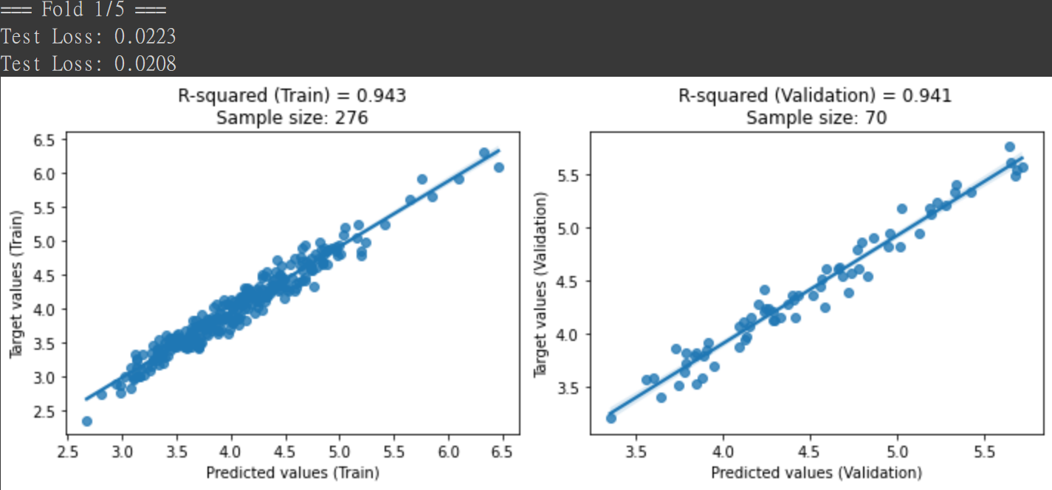

Slide 10
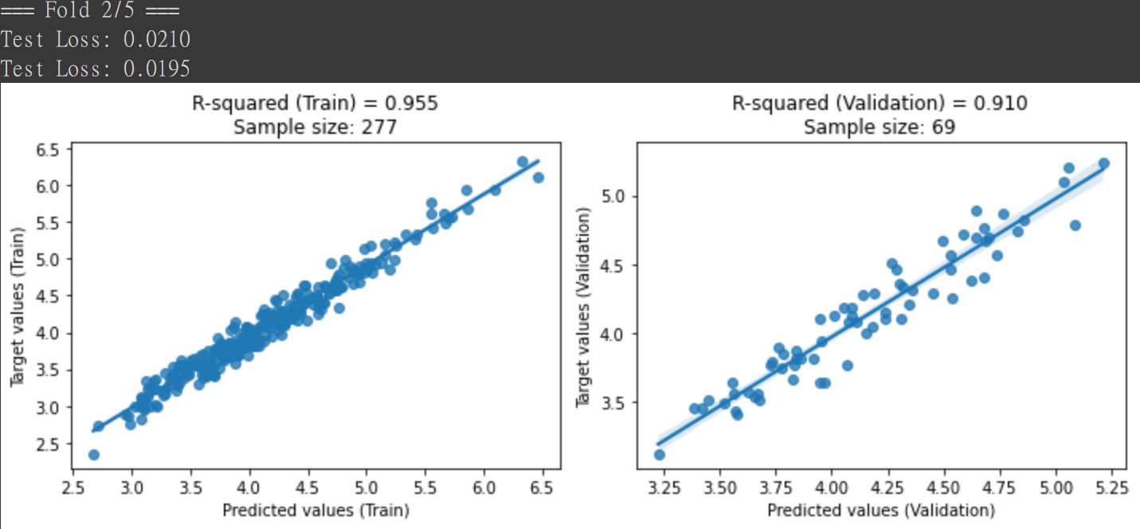

Slide 11
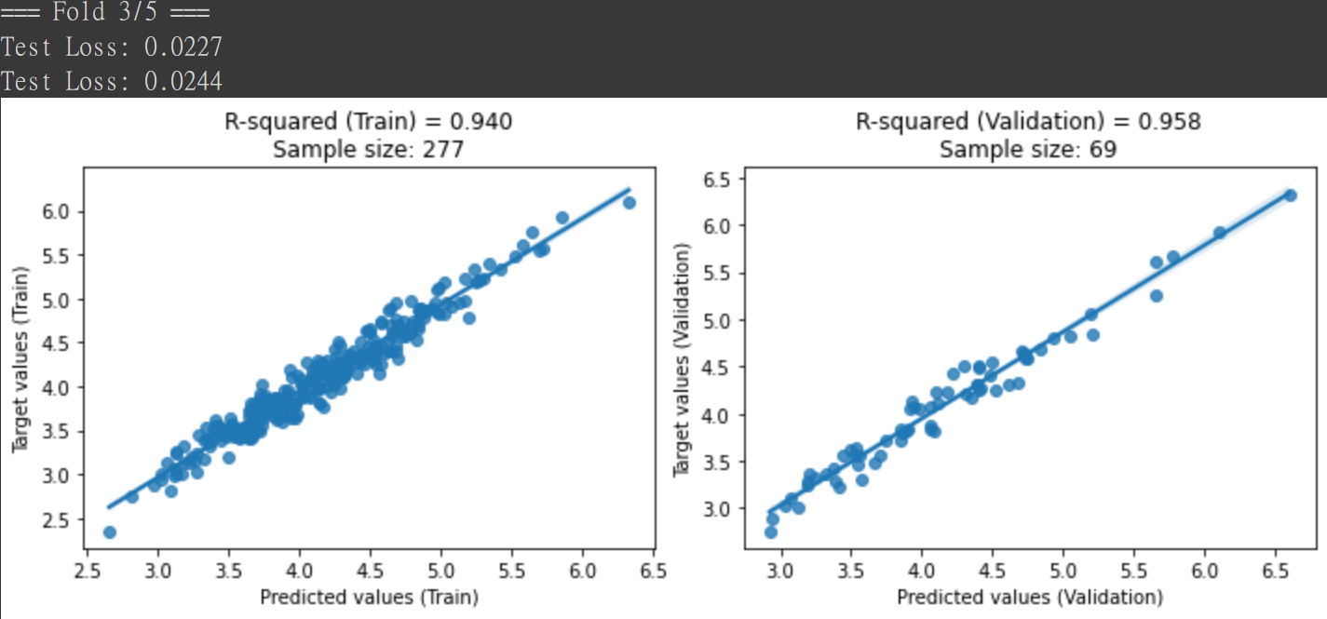

Slide 12
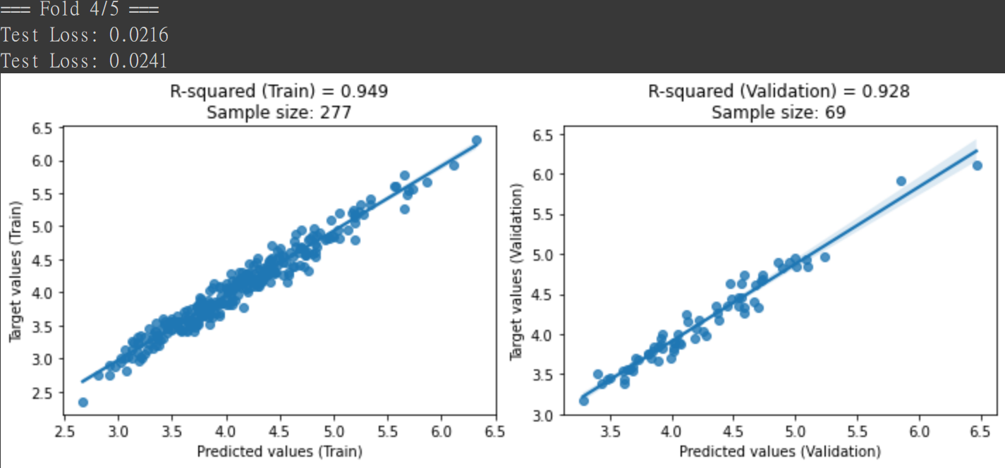

Slide 13
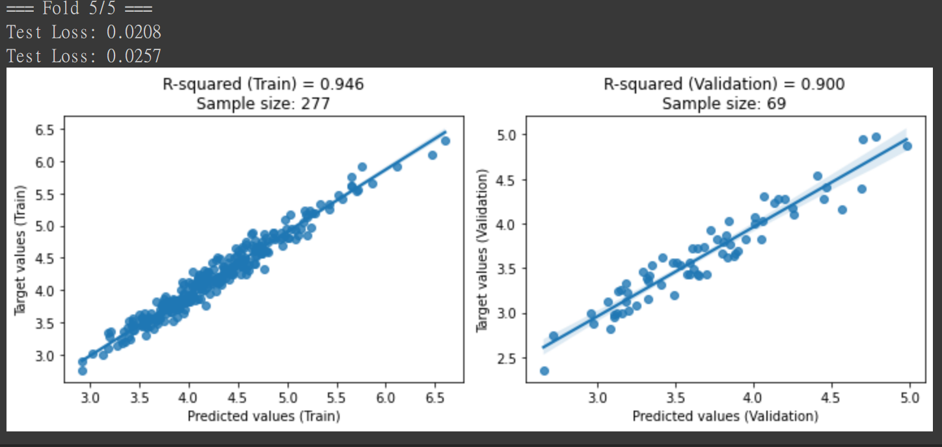

Slide 14
